Slide 1
Number series & Letter series
Concepts, Solved Examples & Preparation Strategies

Slide 2
Number series & Letter series

Slide 3
Tips to solve number series Questions:
Some steps which may be helpful to solve number series.
Step 1: Check the difference
Step 2: If step 1 does not work, then check the difference of difference. If it also does not work, try to find is there any multiplication or division relationship between numbers?
Step 3: If a difference is sharply increasing or decreasing, then you can guess that it may be due to the multiplication or division pattern of series.
Step 4: If there is more irregularity indifference, then it may be the combination
Step 5: If none of the steps works, then try to use the elimination method, which may help you in eliminating 2 to 3 options
01

Slide 4
Direction: What should come in the place of question mark ‘?’ in the given questions. 1. 999, 728, 511, ?, 215
124
342
125
143
None of these
01

Slide 5
01
Direction: What should come in place of question mark (?) in the following number series?
2. 9, 16, 30, ?, 114, 226
56
62
54
58

Slide 6
Direction: Find the missing number in the given series.
3. 32, ?, 92, 134, 184
58
60
64
66
01

Slide 7
Direction: What should come in place of question mark (?) in the following number series?
4. 2, 12, 30, 56, ?
90
80
70
60
01

Slide 8
01
Direction: What should come in place of question mark (?) in the following number series?
5. 12, 19, 45, 108, 232, ?
335
480
447
538
409

Slide 9
01
Direction: What will come in place of the question mark (?) in the following number series?
6. 2, 7, 17, ?, 77, 157
27
37
47
57
None of these

Slide 10
Direction: What will come in place of the question mark (?) in the following number series? 7. 7, 24, 38, 86, 162, ?
259
269
324
334
314
01

Slide 11
Direction: What should come at the place of question mark (?) in the following number series?
8. 6, 23, 47, ?, 130, 189
84
82
65
75
85
01

Slide 12
Direction: What will come in place of the question mark (?) in the following number series?
9. 82, ?, 286, 373, 436, 451
155
175
139
145
187
01

Slide 13
Direction: What should come in place of question mark (?) in the following number series?
10. 100, 198, 294, 388, 480, 570, ?
652
654
656
658
662
01

Slide 14
Direction: What should come in place of question mark (?) in the following number series?
11. 24 26 56 176 720 ?
3632
3440
3655
3800
3600
01

Slide 15
01
Direction: What will come in place of the question mark (?) in the following number series?
12. 9, 15, 27, ?, 69, 99
48
42
38
45
52

Slide 16
Direction: What will come in place of the question mark (?) in the following number series?
13. 7, 8, 12, 21, ?, 62
42
51
48
35
None of these
01

Slide 17
Direction: What will come in place of the question mark (?) in the following number series?
14. 5, 15, 37, 63, 101, ?
95
265
152
206
143
01

Slide 18
Direction: What will come in place of the question mark (?) in the following number series?
15. 2, 12, 36, 80, 150, ?
255
245
248
252
None of these
01

Slide 19
Direction: What should come in place of question mark (?) in the following number series?
16. 15, 21, 39, 77, 143, ?
243
250
253
245
255
01

Slide 20
Direction: What should come in place of question mark (?) in the following number series? 17. 248, 217, 188, 165, ? , 129, 116
146
136
134
147
156
01

Slide 21
Direction: What should come in place of question mark (?) in the following number series?
18. 0, 6, 20, 42, ?, 110, 156
60
64
68
72
88
01

Slide 22
Direction: What should come in place of question mark (?) in the following number series?
19. 65 54 64 55 63 ?
65
55
56
66
None of these
01

Slide 23
Direction: In the following number series, only one number is incorrect. Find out the wrong number in the series.
20. 66, 75, 70, 79, ?, 83
74
65
81
72
01

Slide 24
Direction: Find the wrong term in the given series.
21. 87, 88, 80, 107, 43, 166
88
166
43
80
01

Slide 25
Direction: Find the wrong number in the following series
22. 2, 4, 11, 33, 100, 300
300
11
33
100
01

Slide 26
Direction: Find the wrong number in the following series
23. 11, 22, 35, 52, 75, 106, 143
35
52
75
106
143
01

Slide 27
Direction: Find the wrong number in the following series
24. 4, 14, 28, 58, 151, 502
14
151
502
4
28
01

Slide 28
Direction: Find the wrong number in the following series
26, 37, 50, 65, 82, 100
100
37
65
82
01

Slide 29
Direction: Find the wrong number in the following series
26. 100, 118, 136, 149, 160, 167, 172
100
118
136
149
160
01

Slide 30
Direction: Find the wrong number in the following series
27. 160, 80, 80, 120, 240, 600, 900
900
1800
240
80
01

Slide 31
Direction: Find the wrong number in the following series
28. 5040, 2520, 840, 210, 42, 8, 1
8
1
42
840
01

Slide 32
Direction: Find the wrong number in the following series
29. 1000, 500, 250, 50, 10, 5, 1
250
50
10
5
1
01

Slide 33
Direction: Find the wrong number in the following series
30. 15, 17, 26, 151, 200, 929, 1050
17
15
1050
26
929
01

Slide 34
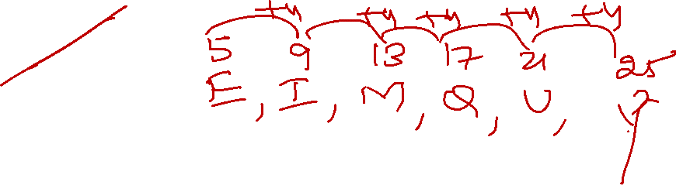
Direction: Find the missing letter in the following series
31. E, I, M, Q, U, ?
Y
W
X
V
01

Slide 35
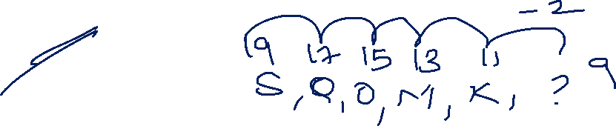
Direction: Find the missing letter in the following series
32. S, Q, O, M, K, ?
J
I
G
F
01

Slide 36
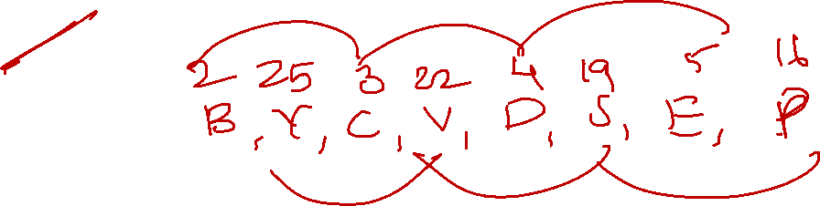
Direction: Find the missing letter in the following series
32. B, Y, C, V, D, S, E, ?
O
P
J
N
01

Slide 37
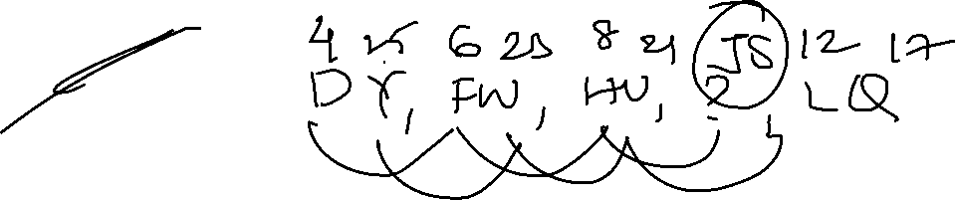
Direction: Find the missing letter in the following series
33. DY, FW, HU, ?, LQ
JR
KR
JS
KS
01

Slide 38
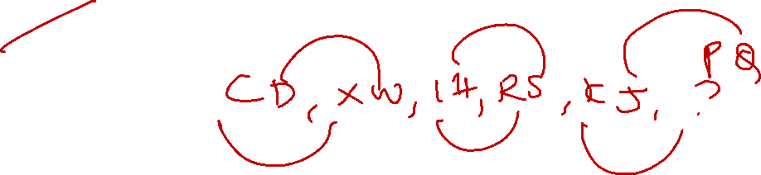
Direction: Find the missing letter in the following series
34. CD, XW, IH, RS, KJ, ?
QR
PQ
ST
TU
01

Slide 39
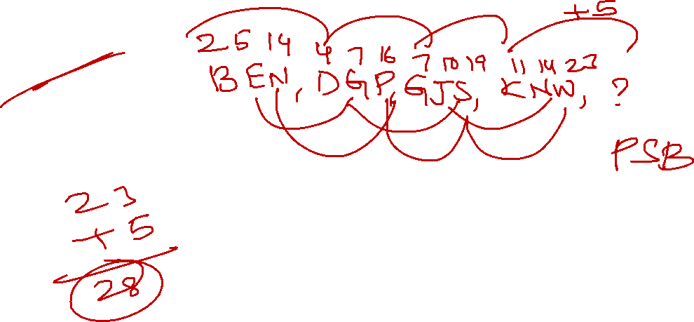
Direction: Find the missing letter in the following series
35. BEN, DGP, GJS, KNW, ?
QSB
PSC
PSA
PSB
01

Slide 40
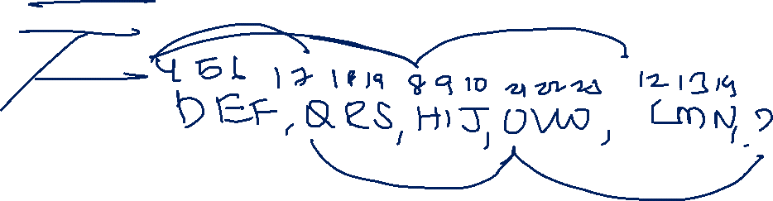
Direction: Find the missing letter/letters in the following series
35. DEF, QRS, HIJ, UVW, LMN, ?
VWX
BCD
YZA
XYZ
01

Slide 41
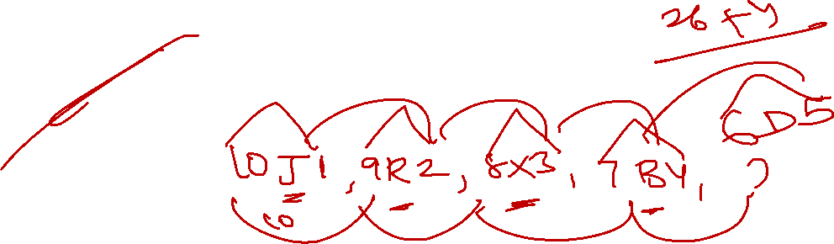
Direction: Find the missing letter/letters in the following series
36. 10J1, 9R2, 8X3, 7B4, ?
6D5
5Y5
6E5
6F6
NONE
01

Slide 42

01

